Slide 1
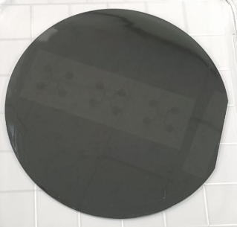
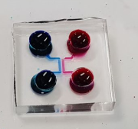
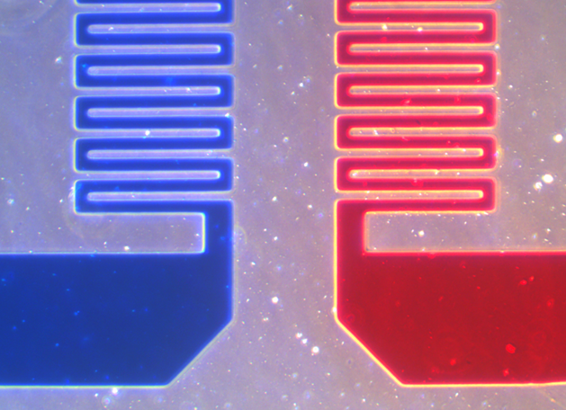
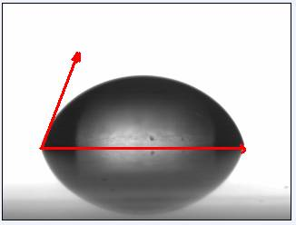
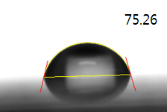
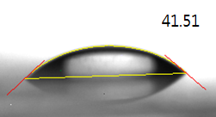
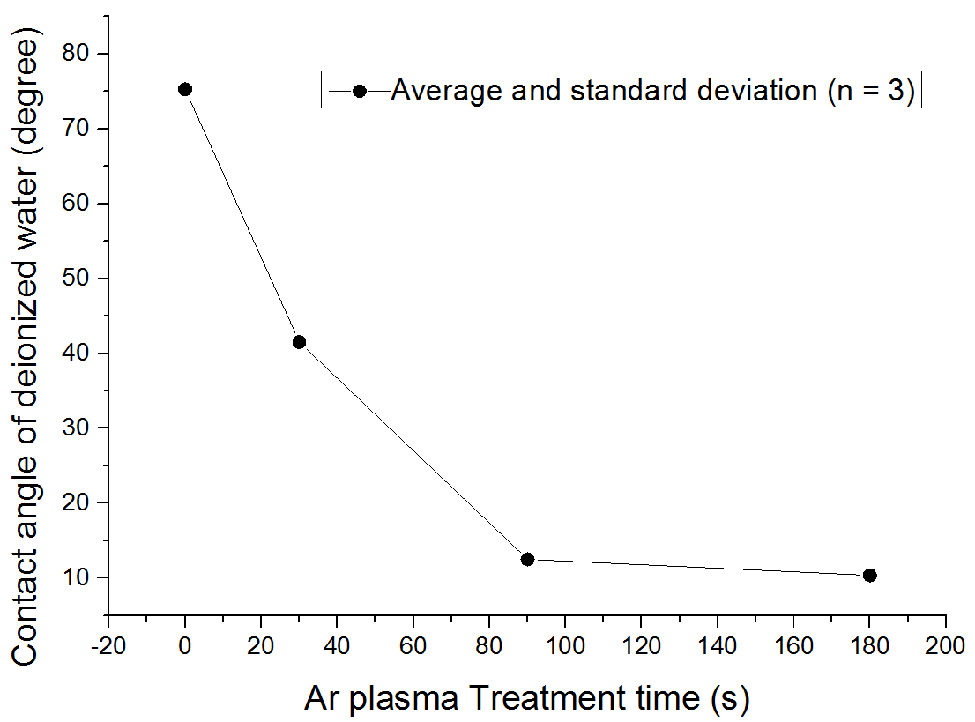
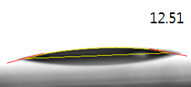
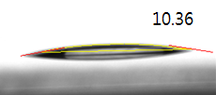
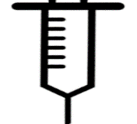
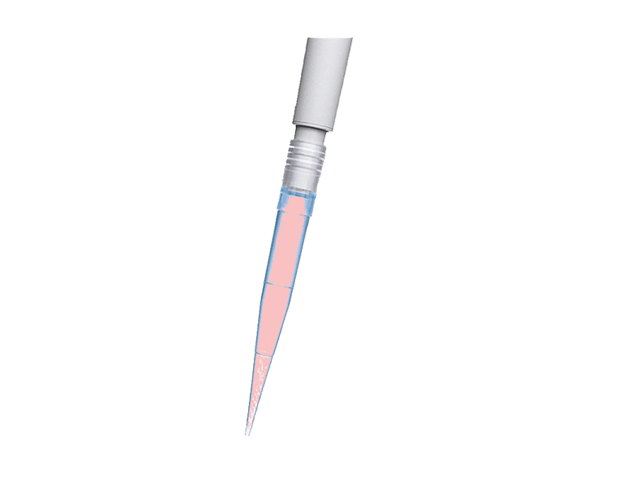
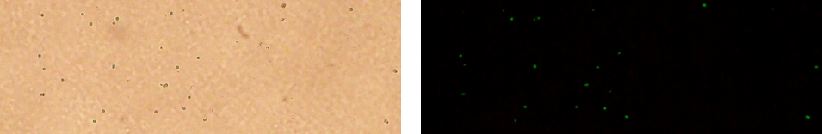
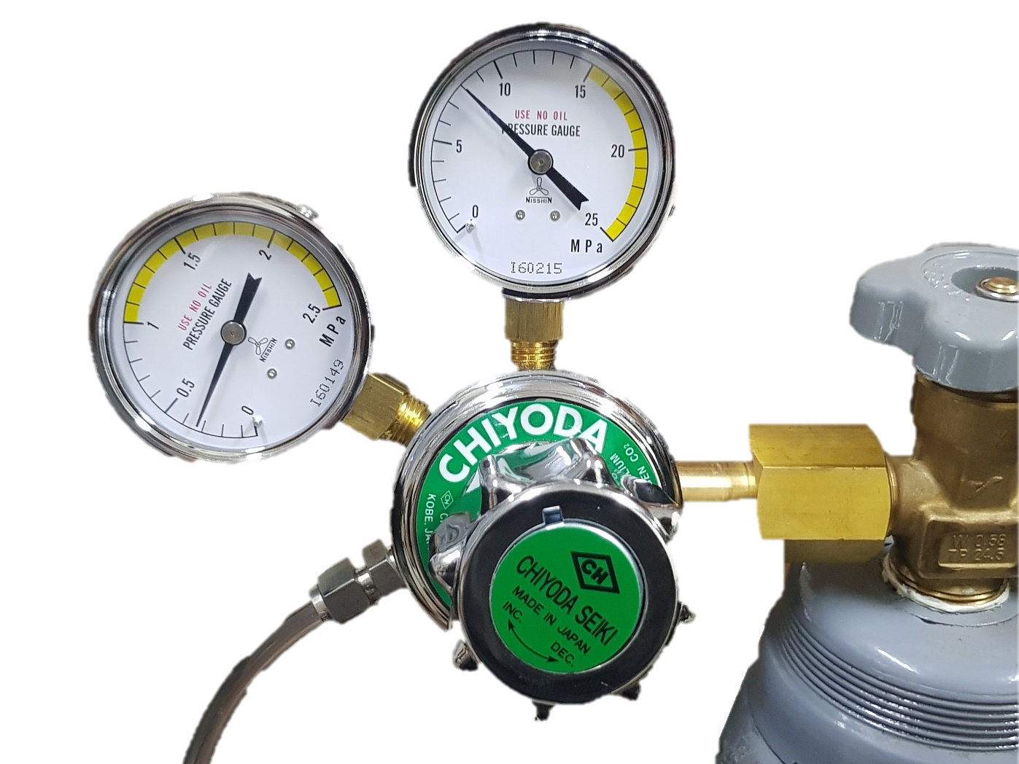
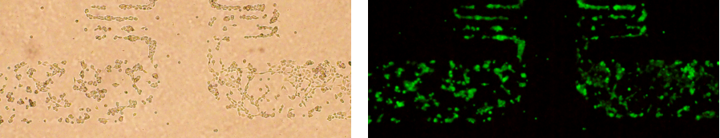
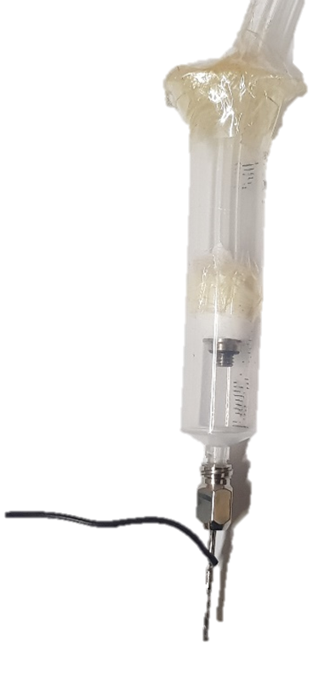
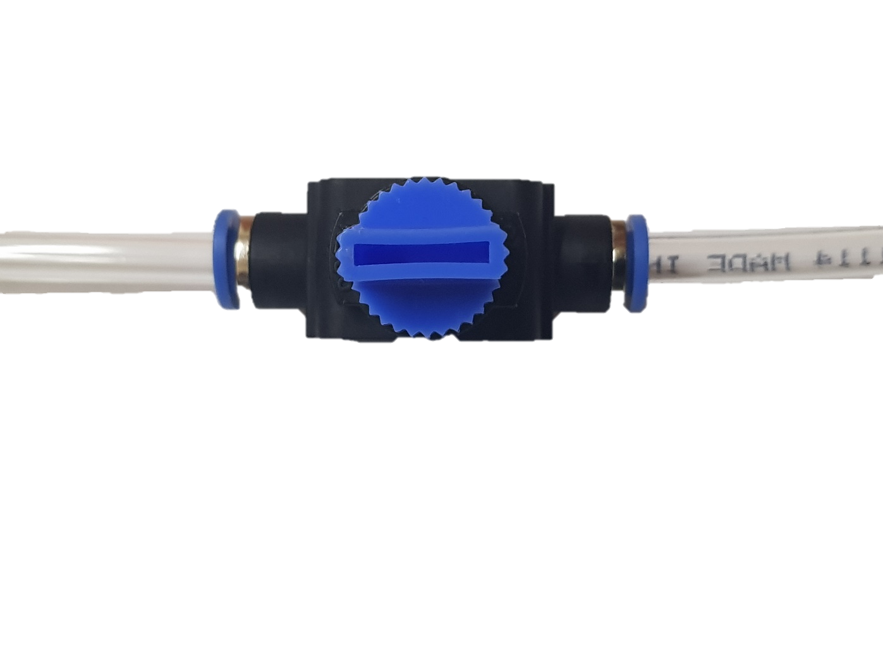
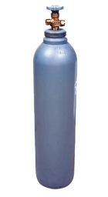
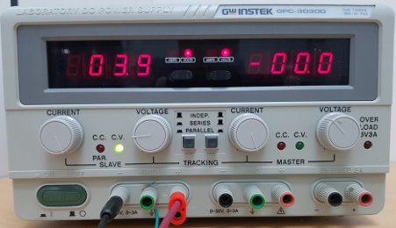
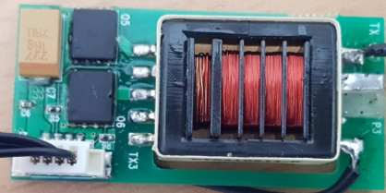
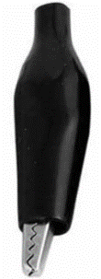
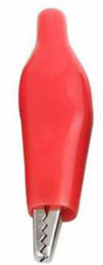
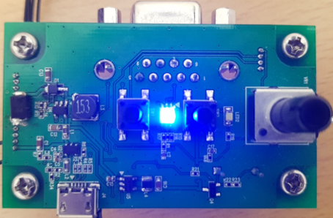
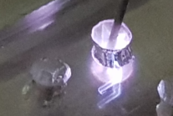
Atmospheric-Pressure and Low-Temperature Plasma Needle
for Biochip Applications
Junsub Kim¹, Jinsoo Park¹, Muhwan Kim², Yeonsook Jang², Somasekhar R. Chinnadayyala^{1,3} and Sungbo Cho^{1,4}*
¹ Department of Health Sciences and Technology, GAHIST, Gachon University, Incheon, Korea
² Femto Science Inc., #505, Kumkang Penterium IT Valley, 557, Dongtangiheung-Ro, Hwaseong, Gyeonggi-do, Korea
³ Department of Biomedical Engineering, Gachon University, Incheon, Korea
⁴ Department of Electronic Engineering, Gachon University, Seongnam, Korea
Introduction
Results
Atmospheric-pressure and low-temperature plasmas have been employed for diverse biomedical applications including the surface treatment of medical devices, inactivation of microorganisms, or the sterilization. Hydrophilic surface modification of the biochip is widely required to immobilize DNA or antibody probes for disease diagnosis, and to pattern the cells for high throughput screening of drug candidates.
In this study, we developed a plasma needle for atmospheric-pressure and low-temperature plasma treatment and evaluated it for hydrophilic surface modification. The plasma needle was constructed using a stainless syringe needle connected to a low frequency power supply for floating at high electrical potential with respect to the ground plate electrode. While the argon gas as working gas was injected through the needle, the plasma was generated and propagated to open air from the needle tip.
The plasma needle was applied to the inlet of the fabricated poly(dimethylsiloxane) microchannel which put on the hydrophobic polystyrene dish. The area of the polystyrene dish treated by atmospheric pressure and low temperature plasma was measured by measuring the contact angle of a water drop and by observing the adhesion and growth of HEK 293/GFP cells. As a result, it was confirmed that his area exhibited a hydrophilic state.
Microfluidic Chip
Microfluidic chip was fabricated to evaluate the hydrophilic surface modification of plasma needle.
Microchannel with a height of 5 μm, width of 40 μm
(a)
(b)
(c)
200 μm
x40
Fabricated SU-8 mold (a), micro-fluidic devise discharge test using bule and red ink (b), (c)
Hydrophilicity versus Ar Plasma Treatment Time
γ_{S} = γ_{SL} + γ_{L} cosθ
γ_{S} : Free energy of interface between solid / gas
γ_{SL} : Free energy of interface between liquid/ solid
γ_{L} : Free energy of interface between liquid / gas
Methodology
γ_{L}
γ_{S}
ɵ = 0 ° : Liquid spreads on the solid surface completely
0° < ɵ < 90 ° : Liquid wetted on solid surface
90° < ɵ < 180 ° : Liquid don’t wetted on solid surface
ɵ = 180 ° : Liquid don’t wetted on solid surface completely
Experimental Procedure
ɵ
γ_{SL}
0sec
30sec
1. Coating of SU-8 (5 μm) on Si-wafer
2. UV exposure
(Power: 360mW, Wavelength: 365 nm)
3. Development of SU-8
90sec
180sec
4. Molding of PDMS
5. Fabrication of PDMS Mold
6. Putting PDMS mold on porystyrene petri dish
Phase contrast & Fluorescent microscope images
Ar Plasma
(a)
(b)
Ground
200 μm
x40
200 μm
x40
7. Ar Plasma treatment
8. Removing PDMS mold
9. Culturing HEK 293/GFP cell
Phase contrast microscope images of HEK 293/GFP cell cultured 3 days on hydrophobic polystyrene petri dish (a), and fluorescent image (b)
Developed Plasma Needle System
(c)
(d)
DC Power supply
200 μm
x40
200 μm
x40
Transformer
+8v
Plasma needle
Ar
Phase contrast microscope images of HEK 293/GFP cell cultured 3 days on Ar plasma treated porystyrene petri dish (c), and fluorescent image (d)
Main board
Ar Plasma
Conclusion
Ground
The developed plasma needle is able to apply the atmospheric-pressure and low-temperature plasma for microfluidic biochip applications.
The hydrophobic surface of the polystyrene petri dish is changed to the hydrophilic state by treating with the plasma needle.
The HEK 293/GFP cells adhere and grow on the plasma-treated polystyrene dish by using the developed plasma needle.
Ar Plasma treatment
Pressure : 0.3MPa (2.96Torr)
Power : 8w
Time : 40s
Acknowledgement
The work was supported by the National Research Foundation of Korea (No. NRF-2017R1D1A1A09000712, 2018R1C1B6009385, 2018M3A9F1023690).

